Slide 1
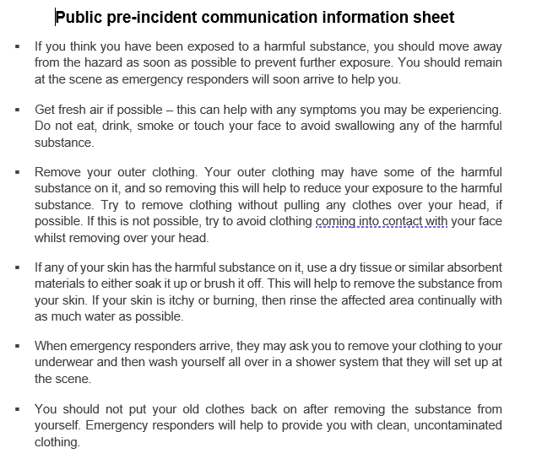
Pre-incident information V1
Notes:
No images used.

Slide 2
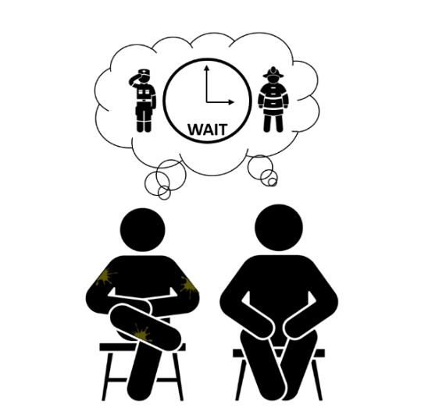
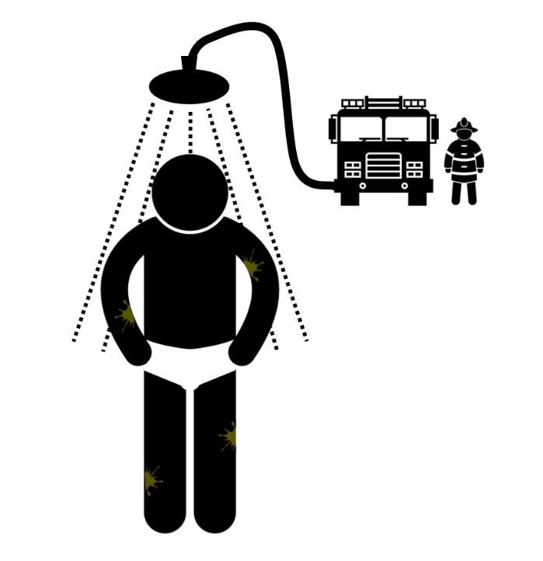
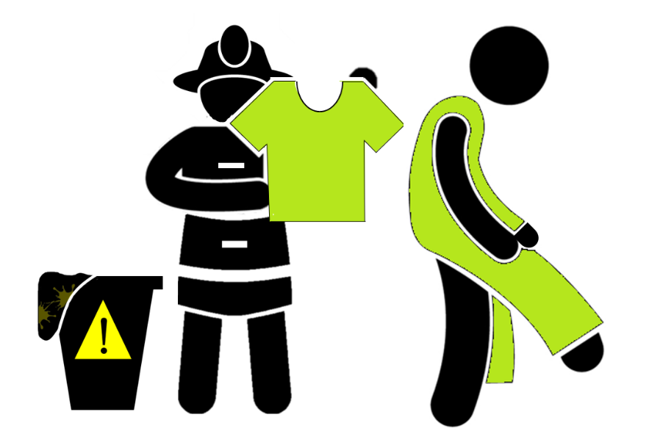
Pre-incident information V2
1
2
3
4
5
6
7
Notes:
1:
Triangle: made on powerpoint
Man walking: Shutterstock
Paint splodge: https://support.shutterstock.com/s/article/Can-I-use-Images-on-my-website?language=en_US#:~:text=Article-,Yes!,is%20less%20than%20%2410%2C000%20USD. Free for personal use.
Door: made on powerpoint
2: All figures (sat down, fire and police): Shutterstock
Thought-bubble: Powerpoint
Clock: made on Powerpoint
Paint splodge: https://support.shutterstock.com/s/article/Can-I-use-Images-on-my-website?language=en_US#:~:text=Article-,Yes!,is%20less%20than%20%2410%2C000%20USD. Free for personal use.
3:
Man: Shutterstock and edited
Red circles: Powerpoint
Paint splodge: https://support.shutterstock.com/s/article/Can-I-use-Images-on-my-website?language=en_US#:~:text=Article-,Yes!,is%20less%20than%20%2410%2C000%20USD. Free for personal use.
4:
Bin: made by me powerpoint
Man: shutterstock and edited
Paint splodge: https://support.shutterstock.com/s/article/Can-I-use-Images-on-my-website?language=en_US#:~:text=Article-,Yes!,is%20less%20than%20%2410%2C000%20USD. Free for personal use.
5:
Bin: made on powerpoint
Papertowel: Shutterstock
Man: Shutterstock
Paper: https://thenounproject.com/icon/crumpled-paper-1103876/ - free to use
Paint splodge: https://support.shutterstock.com/s/article/Can-I-use-Images-on-my-website?language=en_US#:~:text=Article-,Yes!,is%20less%20than%20%2410%2C000%20USD. Free for personal use.
6:
Fireman + van: Shutterstock
Shower: made in powerpoint
Man: Shutterstock and edited
Paint splodge: https://support.shutterstock.com/s/article/Can-I-use-Images-on-my-website?language=en_US#:~:text=Article-,Yes!,is%20less%20than%20%2410%2C000%20USD. Free for personal use.
7:
Fireman: Shutterstock and edited
Bin: made by me powerpoint
Man: Shutterstock and edited
Paint splodge: https://support.shutterstock.com/s/article/Can-I-use-Images-on-my-website?language=en_US#:~:text=Article-,Yes!,is%20less%20than%20%2410%2C000%20USD. Free for personal use.

Slide 3
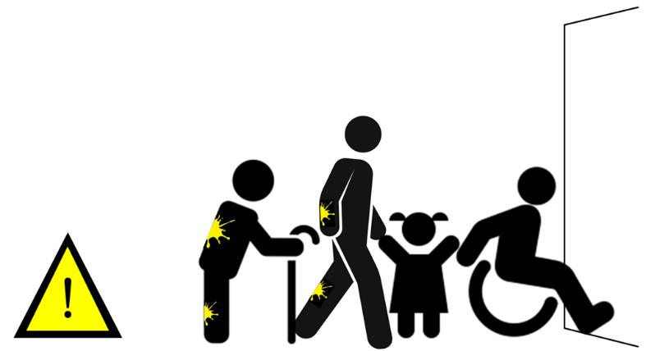
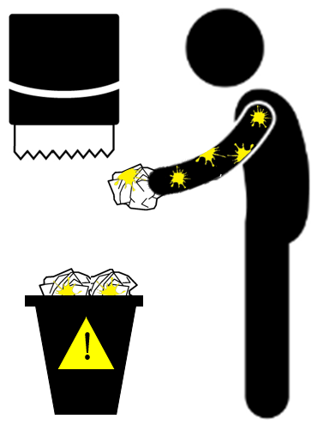
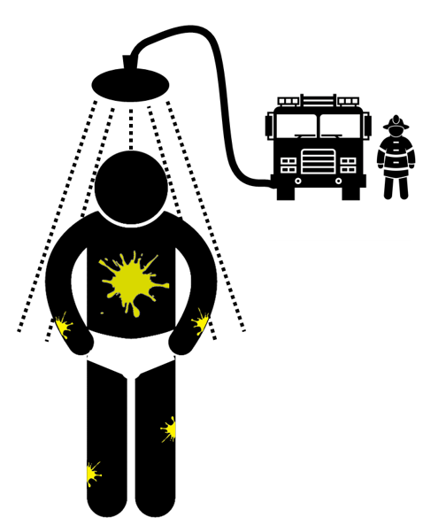
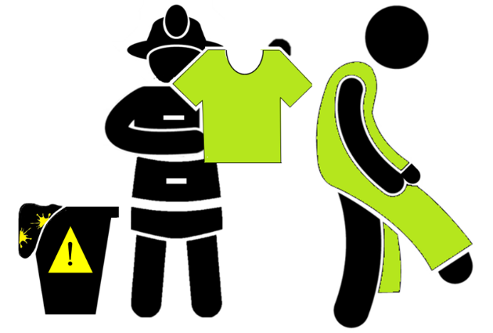
Pre-incident information V3
2
1
3
4
5
6
Notes:
1:
Triangle: made on PowerPoint
Man walking: Shutterstock
Paint splodge: https://support.shutterstock.com/s/article/Can-I-use-Images-on-my-website?language=en_US#:~:text=Article-,Yes!,is%20less%20than%20%2410%2C000%20USD. Free for personal use.
Door: made on PowerPoint
2:
Man: Shutterstock and edited
Red circles: PowerPoint
Paint splodge: https://support.shutterstock.com/s/article/Can-I-use-Images-on-my-website?language=en_US#:~:text=Article-,Yes!,is%20less%20than%20%2410%2C000%20USD. Free for personal use.
3:
Bin: made by me PowerPoint
Man: shutterstock and edited
Paint splodge: https://support.shutterstock.com/s/article/Can-I-use-Images-on-my-website?language=en_US#:~:text=Article-,Yes!,is%20less%20than%20%2410%2C000%20USD. Free for personal use.
4:
Bin: made on powerpoint
Papertowel: Shutterstock
Man: Shutterstock
Paper: https://thenounproject.com/icon/crumpled-paper-1103876/ - free to use
Paint splodge: https://support.shutterstock.com/s/article/Can-I-use-Images-on-my-website?language=en_US#:~:text=Article-,Yes!,is%20less%20than%20%2410%2C000%20USD. Free for personal use.
5:
Fireman + van: Shutterstock
Shower: made in powerpoint
Man: Shutterstock and edited
Paint splodge: https://support.shutterstock.com/s/article/Can-I-use-Images-on-my-website?language=en_US#:~:text=Article-,Yes!,is%20less%20than%20%2410%2C000%20USD. Free for personal use.
6:
Fireman: Shutterstock and edited
Bin: made by me powerpoint
Man: Shutterstock and edited
Paint splodge: https://support.shutterstock.com/s/article/Can-I-use-Images-on-my-website?language=en_US#:~:text=Article-,Yes!,is%20less%20than%20%2410%2C000%20USD. Free for personal use.

Slide 4
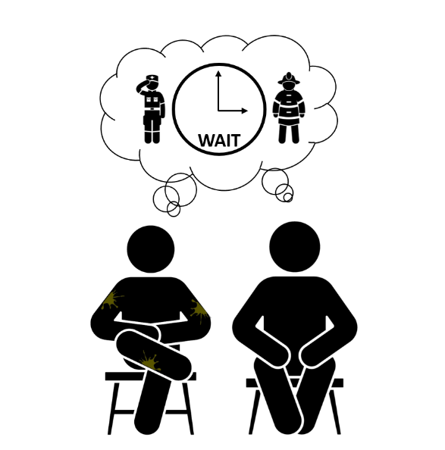
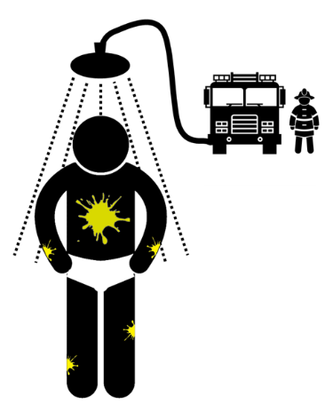
Pre-incident information V4
1
3
4
2
5
6
7
8
Notes:
1:
Triangle: made on powerpoint
Man walking: Shutterstock
Paint splodge: https://support.shutterstock.com/s/article/Can-I-use-Images-on-my-website?language=en_US#:~:text=Article-,Yes!,is%20less%20than%20%2410%2C000%20USD. Free for personal use.
Door: made on powerpoint
2: All figures (sat down, fire and police): Shutterstock
Thought-bubble: Powerpoint
Clock: made on Powerpoint
Paint splodge: https://support.shutterstock.com/s/article/Can-I-use-Images-on-my-website?language=en_US#:~:text=Article-,Yes!,is%20less%20than%20%2410%2C000%20USD. Free for personal use.
3:
Man: Shutterstock and edited
Red circles: Powerpoint
Paint splodge: https://support.shutterstock.com/s/article/Can-I-use-Images-on-my-website?language=en_US#:~:text=Article-,Yes!,is%20less%20than%20%2410%2C000%20USD. Free for personal use.
4:
Bin: made by me powerpoint
Man: shutterstock and edited
Paint splodge: https://support.shutterstock.com/s/article/Can-I-use-Images-on-my-website?language=en_US#:~:text=Article-,Yes!,is%20less%20than%20%2410%2C000%20USD. Free for personal use.
5:
Bin: made on powerpoint
Papertowel: Shutterstock
Man: Shutterstock
Paper: https://thenounproject.com/icon/crumpled-paper-1103876/ - free to use
Paint splodge: https://support.shutterstock.com/s/article/Can-I-use-Images-on-my-website?language=en_US#:~:text=Article-,Yes!,is%20less%20than%20%2410%2C000%20USD. Free for personal use.
6:
Fireman + van: Shutterstock
Shower: made in powerpoint
Man: Shutterstock and edited
Paint splodge: https://support.shutterstock.com/s/article/Can-I-use-Images-on-my-website?language=en_US#:~:text=Article-,Yes!,is%20less%20than%20%2410%2C000%20USD. Free for personal use.
7:
Fireman: Shutterstock and edited
Bin: Made on powerpoint
Man: Shutterstock and edited
Paint splodge: https://support.shutterstock.com/s/article/Can-I-use-Images-on-my-website?language=en_US#:~:text=Article-,Yes!,is%20less%20than%20%2410%2C000%20USD. Free for personal use.
8:
Men: Shutterstock
Triangle: Made on Powerpoint
Tree: tree (1687 images) - Free SVG Image & Icon. | SVG Silh Free to use
Clothes on floor: Created and edited on Powerpoint
Paint splodge: https://support.shutterstock.com/s/article/Can-I-use-Images-on-my-website?language=en_US#:~:text=Article-,Yes!,is%20less%20than%20%2410%2C000%20USD. Free for personal use.

Slide 5
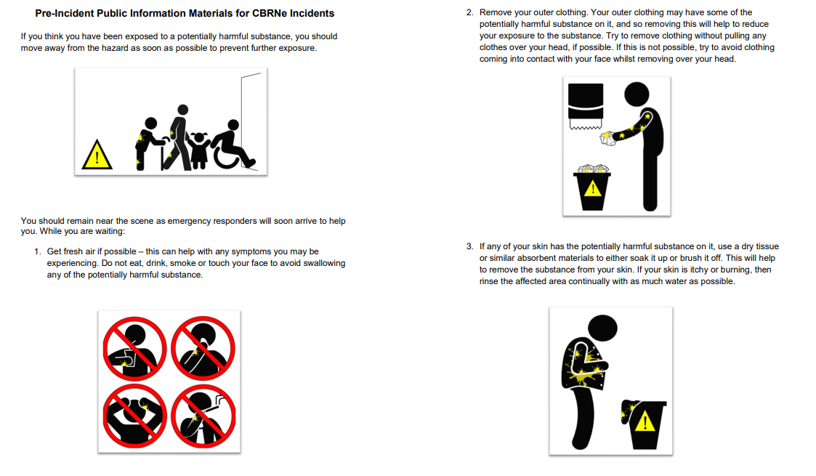
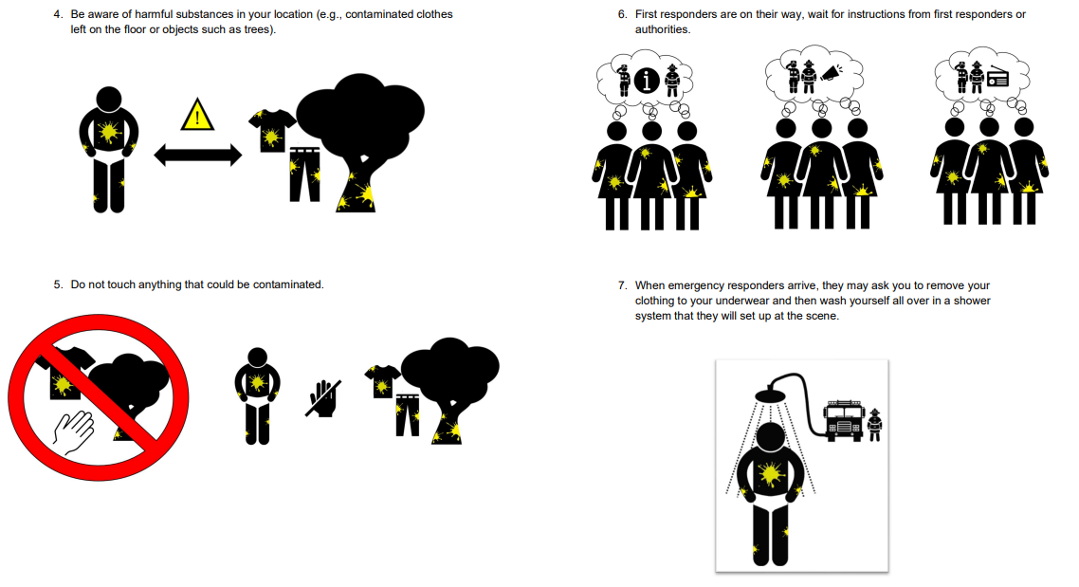
Pre-incident information V5
1
2
3
4
7
5
6
8
9
Notes:
1:
Triangle: made on powerpoint
Man walking: Shutterstock
Man with stick/wheelchair/child: Shutterstock? All sent over by Laura
Paint splodge: https://support.shutterstock.com/s/article/Can-I-use-Images-on-my-website?language=en_US#:~:text=Article-,Yes!,is%20less%20than%20%2410%2C000%20USD. Free for personal use.
Door: made on powerpoint
2:
Bin: made on powerpoint
Paper towel: Shutterstock
Man: Shutterstock
Paper: https://thenounproject.com/icon/crumpled-paper-1103876/ - free to use
Paint splodge: https://support.shutterstock.com/s/article/Can-I-use-Images-on-my-website?language=en_US#:~:text=Article-,Yes!,is%20less%20than%20%2410%2C000%20USD. Free for personal use.
3:
Man: Shutterstock and edited
Warning sign: made on Powerpoint
Tree: tree (1687 images) - Free SVG Image & Icon. | SVG Silh Free to use
Tshirt: Powerpoint icon
Trousers: Powerpoint icon
Paint splodge: https://support.shutterstock.com/s/article/Can-I-use-Images-on-my-website?language=en_US#:~:text=Article-,Yes!,is%20less%20than%20%2410%2C000%20USD. Free for personal use.
4:
All groups of people: Shutterstock
Icons in thought bubbles all from Powerpoint
Paint splodge: https://support.shutterstock.com/s/article/Can-I-use-Images-on-my-website?language=en_US#:~:text=Article-,Yes!,is%20less%20than%20%2410%2C000%20USD. Free for personal use.
5:
Man: Shutterstock and edited
Red circles: Powerpoint
Paint splodge: https://support.shutterstock.com/s/article/Can-I-use-Images-on-my-website?language=en_US#:~:text=Article-,Yes!,is%20less%20than%20%2410%2C000%20USD. Free for personal use.
6:
Bin: made by me powerpoint
Man: shutterstock and edited
Paint splodge: https://support.shutterstock.com/s/article/Can-I-use-Images-on-my-website?language=en_US#:~:text=Article-,Yes!,is%20less%20than%20%2410%2C000%20USD. Free for personal use.
7:
Red circle: Powerpoint
Hand: Powerpoint icon
Tree: tree (1687 images) - Free SVG Image & Icon. | SVG Silh Free to use
Tshirt: Powerpoint icon
Trousers: Powerpoint icon
Paint splodge: https://support.shutterstock.com/s/article/Can-I-use-Images-on-my-website?language=en_US#:~:text=Article-,Yes!,is%20less%20than%20%2410%2C000%20USD. Free for personal use.
8:
Fireman + van: Shutterstock
Shower: made in powerpoint
Man: Shutterstock and edited
Paint splodge: https://support.shutterstock.com/s/article/Can-I-use-Images-on-my-website?language=en_US#:~:text=Article-,Yes!,is%20less%20than%20%2410%2C000%20USD. Free for personal use.
7:
Fireman: Shutterstock and edited
Bin: Made on powerpoint
Man: Shutterstock and edited
Paint splodge: https://support.shutterstock.com/s/article/Can-I-use-Images-on-my-website?language=en_US#:~:text=Article-,Yes!,is%20less%20than%20%2410%2C000%20USD. Free for personal use.

Slide 6
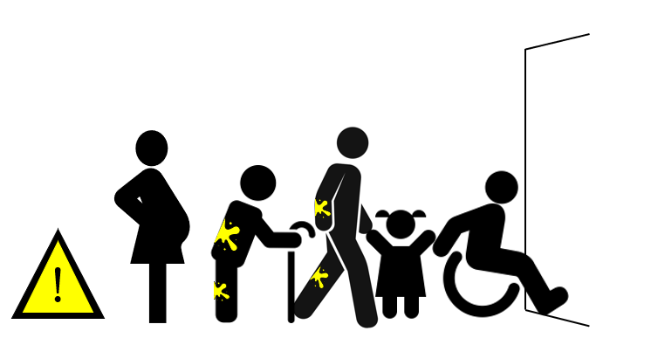
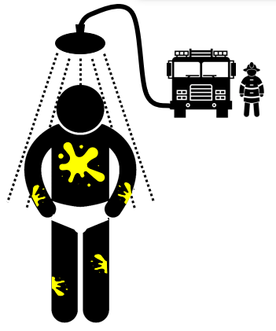
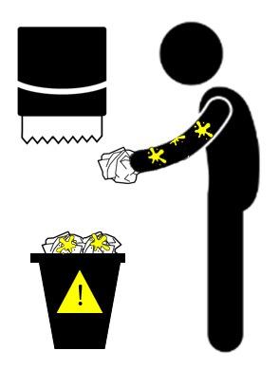
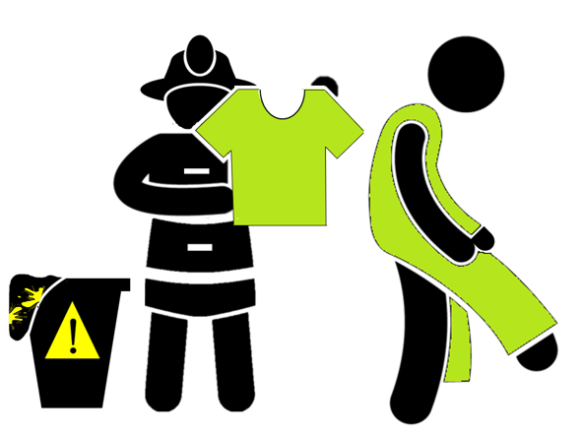
Pre-incident information V6
1
2
3
4
5
8
6
7
9
Notes:
1:
Triangle: made on powerpoint
Man walking: Shutterstock
Man with stick/wheelchair/child: Shutterstock? All sent over by Laura
Paint splodge: Created and edited on powerpoint
Door: made on powerpoint
Pregnant woman: Powerpoint icon
2:
Man: Shutterstock and edited
Red circles: Powerpoint
Paint splodge: Powerpoint
3:
Bin: made by me powerpoint
Man: shutterstock and edited
Paint splodge: Powerpoint
4:
Red circle: Powerpoint
Hand: Powerpoint
Tree: tree (1687 images) - Free SVG Image & Icon. | SVG Silh Free to use
Tshirt: Powerpoint
Trousers: Powerpoint
Bench: Shuttershock
Paint splodge: Powerpoint
5:
Man: Powerpoint icon
Woman: Powerpoint icon
Arrow: Powerpoint
Paint splodge: Powerpoint
6:
Fireman + van: Shutterstock
Shower: Powerpoint
Man: Shutterstock and edited
Paint splodge: Powerpoint
7:
Bin: made on powerpoint
Papertowel: Shutterstock
Man: Shutterstock
Paper: https://thenounproject.com/icon/crumpled-paper-1103876/ - free to use
Paint splodge: Powerpoint
8:
Car: https://en.wikivoyage.org/wiki/File:Car_icon_alone.png – free to use
Fireman + policeman: Shutterstock + edited also sent by Laura
Megaphone: powerpoint icon and edited
9:
Fireman: Shutterstock and edited
Bin: Made on powerpoint
Man: Shutterstock and edited
Paint splodge: Powerpoint

Slide 7
Pre-incident information V7
1
2
3
4
5
8
9
6
7
Notes:
1:
Triangle: made on powerpoint
Man walking: Shutterstock
Man with stick/wheelchair/child: Shutterstock? All sent over by Laura
Paint splodge: Powerpoint
Door: made on powerpoint
Pregnant woman: Powerpoint icon
2:
Man: Shutterstock and edited
Red circles: Powerpoint
Paint splodge: Powerpoint
3:
Bin: made by me powerpoint
Man: shutterstock and edited
Paint splodge: Powerpoint
4:
Red circle: Powerpoint
Hand: Powerpoint icon
Tree: tree (1687 images) - Free SVG Image & Icon. | SVG Silh Free to use
Tshirt: Powerpoint icon
Trousers: Powerpoint icon
Bench: Shuttershock
Paint splodge: Powerpoint
5:
Man: Powerpoint icon
Woman: Powerpoint icon
Arrow: Powerpoint
Paint splodge: Powerpoint
6:
Fireman + van: Shutterstock
Shower: Powerpoint
Man: Shutterstock and edited
Paint splodge: Meg
7:
Bin: made on powerpoint
Papertowel: Shutterstock
Man: Shutterstock
Paper: https://thenounproject.com/icon/crumpled-paper-1103876/ - free to use
Paint splodge: Powerpoint
8:
Car: https://en.wikivoyage.org/wiki/File:Car_icon_alone.png – free to use
Fireman + policeman: Shutterstock + edited also sent by Laura
Megaphone: powerpoint icon and edited
9:
Fireman: Shutterstock and edited
Bin: Made on powerpoint
Man: Shutterstock and edited
Paint splodge: Powerpoint

